Slide 1
Translation Scheme using Backpatching
One pass Translation
Only synthesized attributes - list of jumps are passed as synthesized attributes
Suitable for bottom up parsing
Uses position numbers

Slide 2
Backpatching for Boolean Expressions
Now we will design a translation scheme suitable for generating code for boolean expression during bottom up parsing.
A marker nonterminal M in the grammar causes a semantic action to pick up, at appropriate times, the index of the next instruction to be generated.

Slide 3
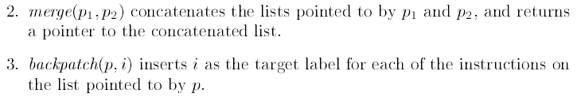
To manipulate list of jumps, three functions are used

Slide 4

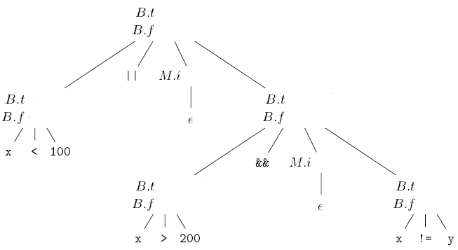







Attributes truelist, falselist, instr are represented by t,f and i respectively

Slide 5
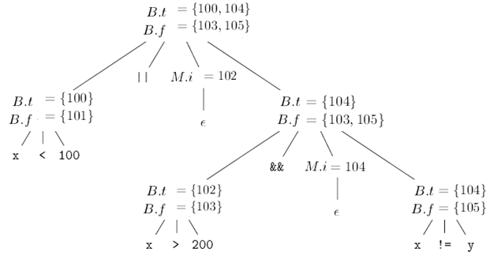



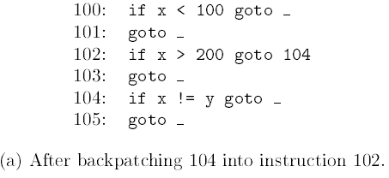
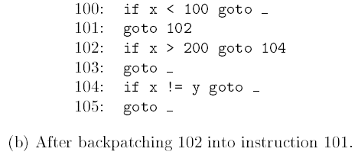
Translation using backpatching
Steps in the backpatching process

Slide 6


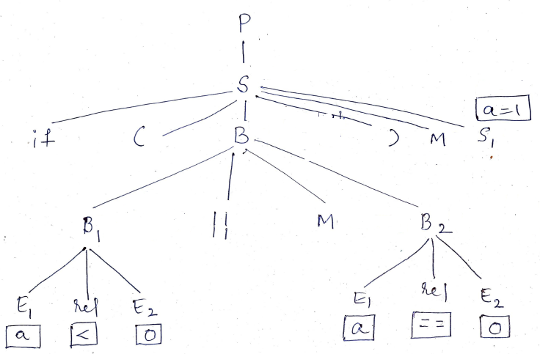
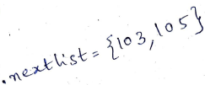












Slide 7

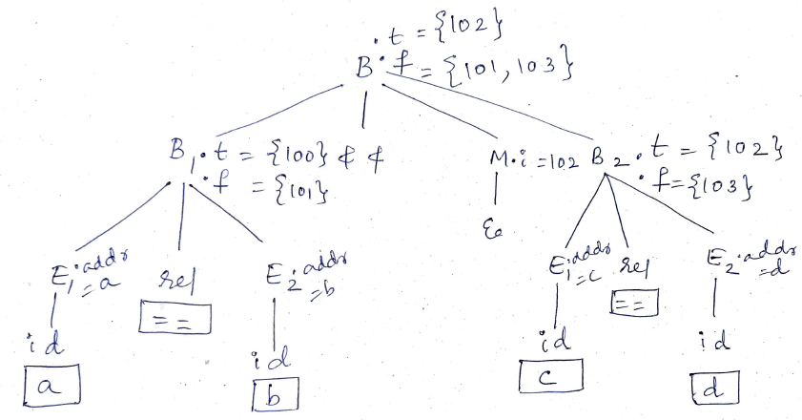
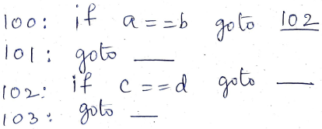
Translation of
Three Address Code

Slide 8
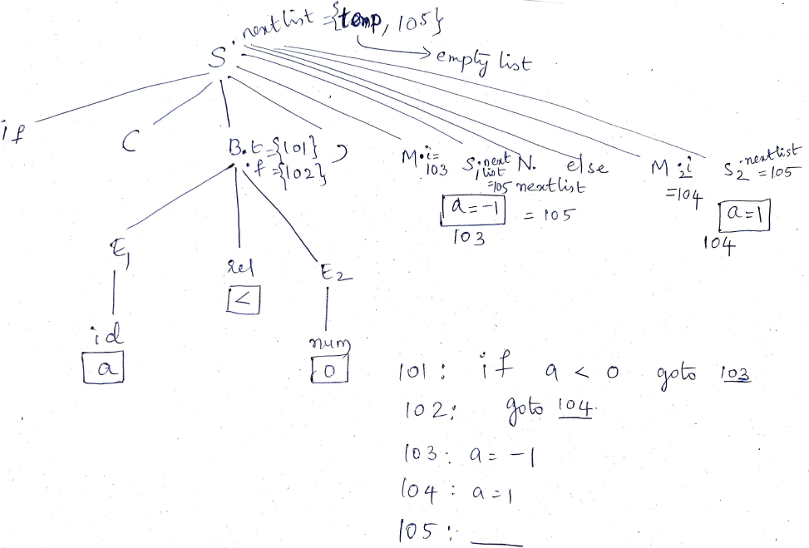
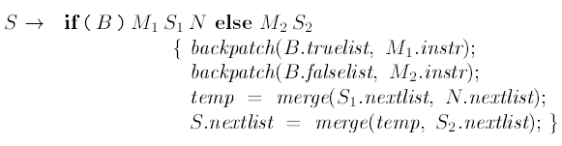
If else statement

